Slide 1

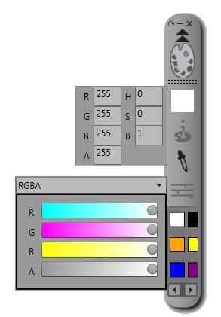

Color Preview
Color Values
Eyedropper
RGBA/HSLA/HSBA Sliders
Color Swatches

Slide 2



Fill Color
Outline/Stroke Color
Stroke weight
Draw Shapes
Draw Lines
Text
Marker
Highlighter
Eraser
Cursor
Clear drawing
Save Drawing

Slide 3


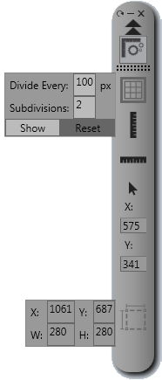
Grid Screen Overlay
Vertical Screen Ruler
Horizontal Screen Ruler
Mouse Cursor Coordinates
Selection Measurement

Slide 4
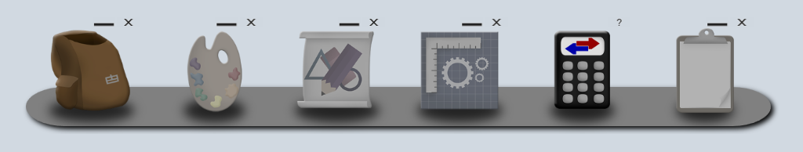
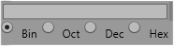


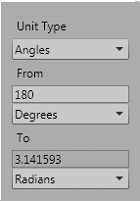
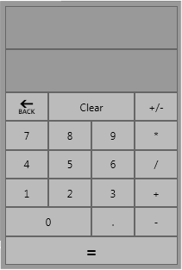
ASCII/Unicode Conversion
Integer Base Conversion
Common Unit Conversion
Basic Calculator

Slide 5


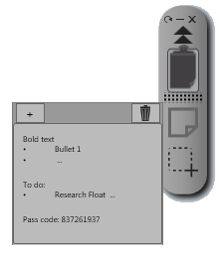
Quick notes
Screen Clipping

